Slide 2
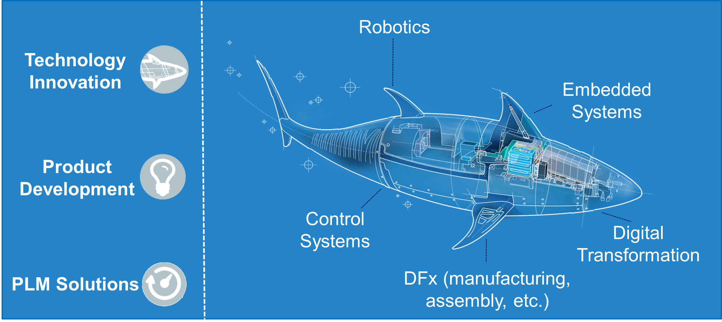
Boston Engineering’s Mission
“To improve the way people work and live through innovative product design and novel engineering”
Notes:
Good afternoon everyone, I am Mike Rufo, VP of R&D at Boston Engineering Corp. Thanks to Toby and his team for the opportunity to speak today. At Boston Engineering, we endeavor everyday to apply our core capabilities to improve the way people work and live.

Slide 3
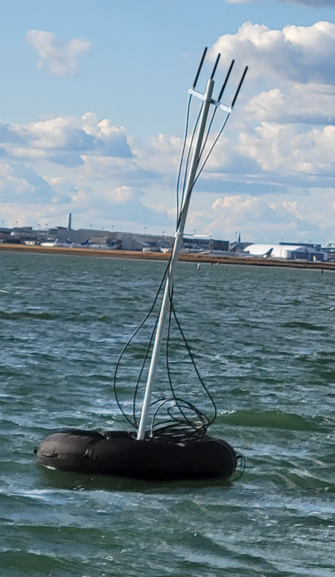
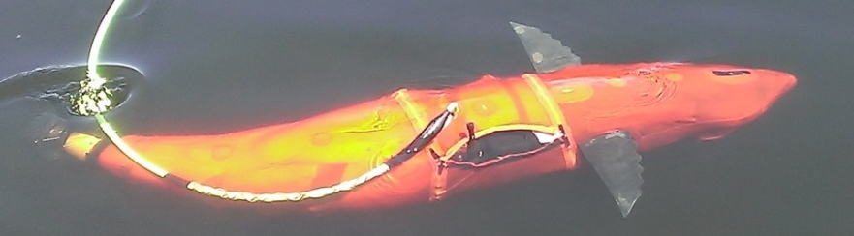
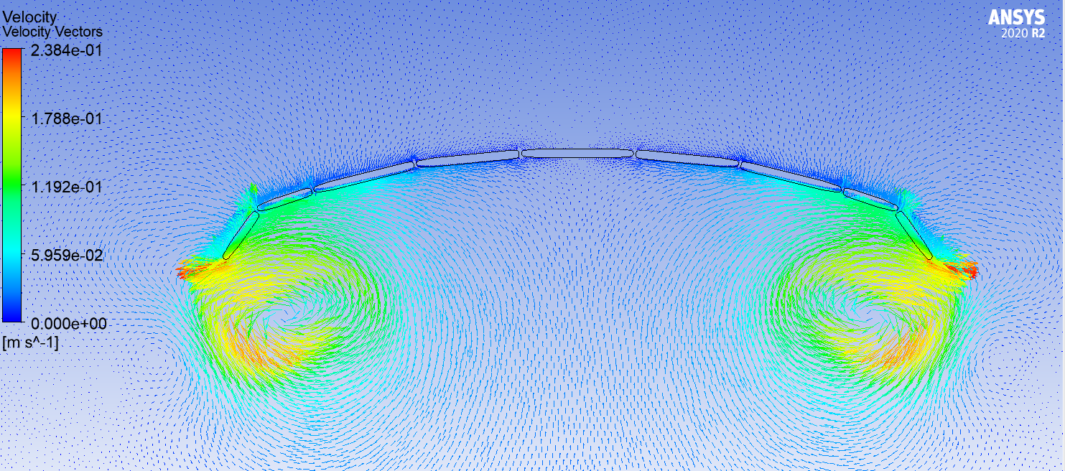
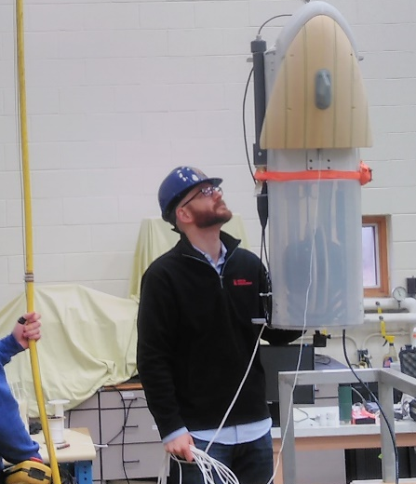
Proven Technologies for the Blue Economy and Beyond
Distribution A
Notes:
Our work in the maritime space ranges from bio-inspired, next generation UUVs, underwater winches, novel crawling robots, and more. Yes, that is a CFD model of a robotic jellyfish in the center. We develop technology to have a high positive impact; from first responders to regular citizens in the path of a hurricane.

Slide 4
Better and More Timely Ocean Data Can Save Lives
100,000 lives lost annually worldwide
Due to tropical storms
22 $B storm and climate damage events
2020: US Only
$997.3B in storm damages
1980 – 2020 US Only
Notes:
The most important aspect of what we do is the data we can acquire. More than ever, ocean data ⌂ is critical. Did you know that from 1980-2020, tropical storms (including hurricanes) cost almost a trillion dollars in damages? ⌂ And its only getting worse. The number of $B events in terms of damages set a new record in 2020… with 22 in the US ALONE. ⌂ And most alarming… 100,000 people die every year from these storms worldwide.

Slide 5
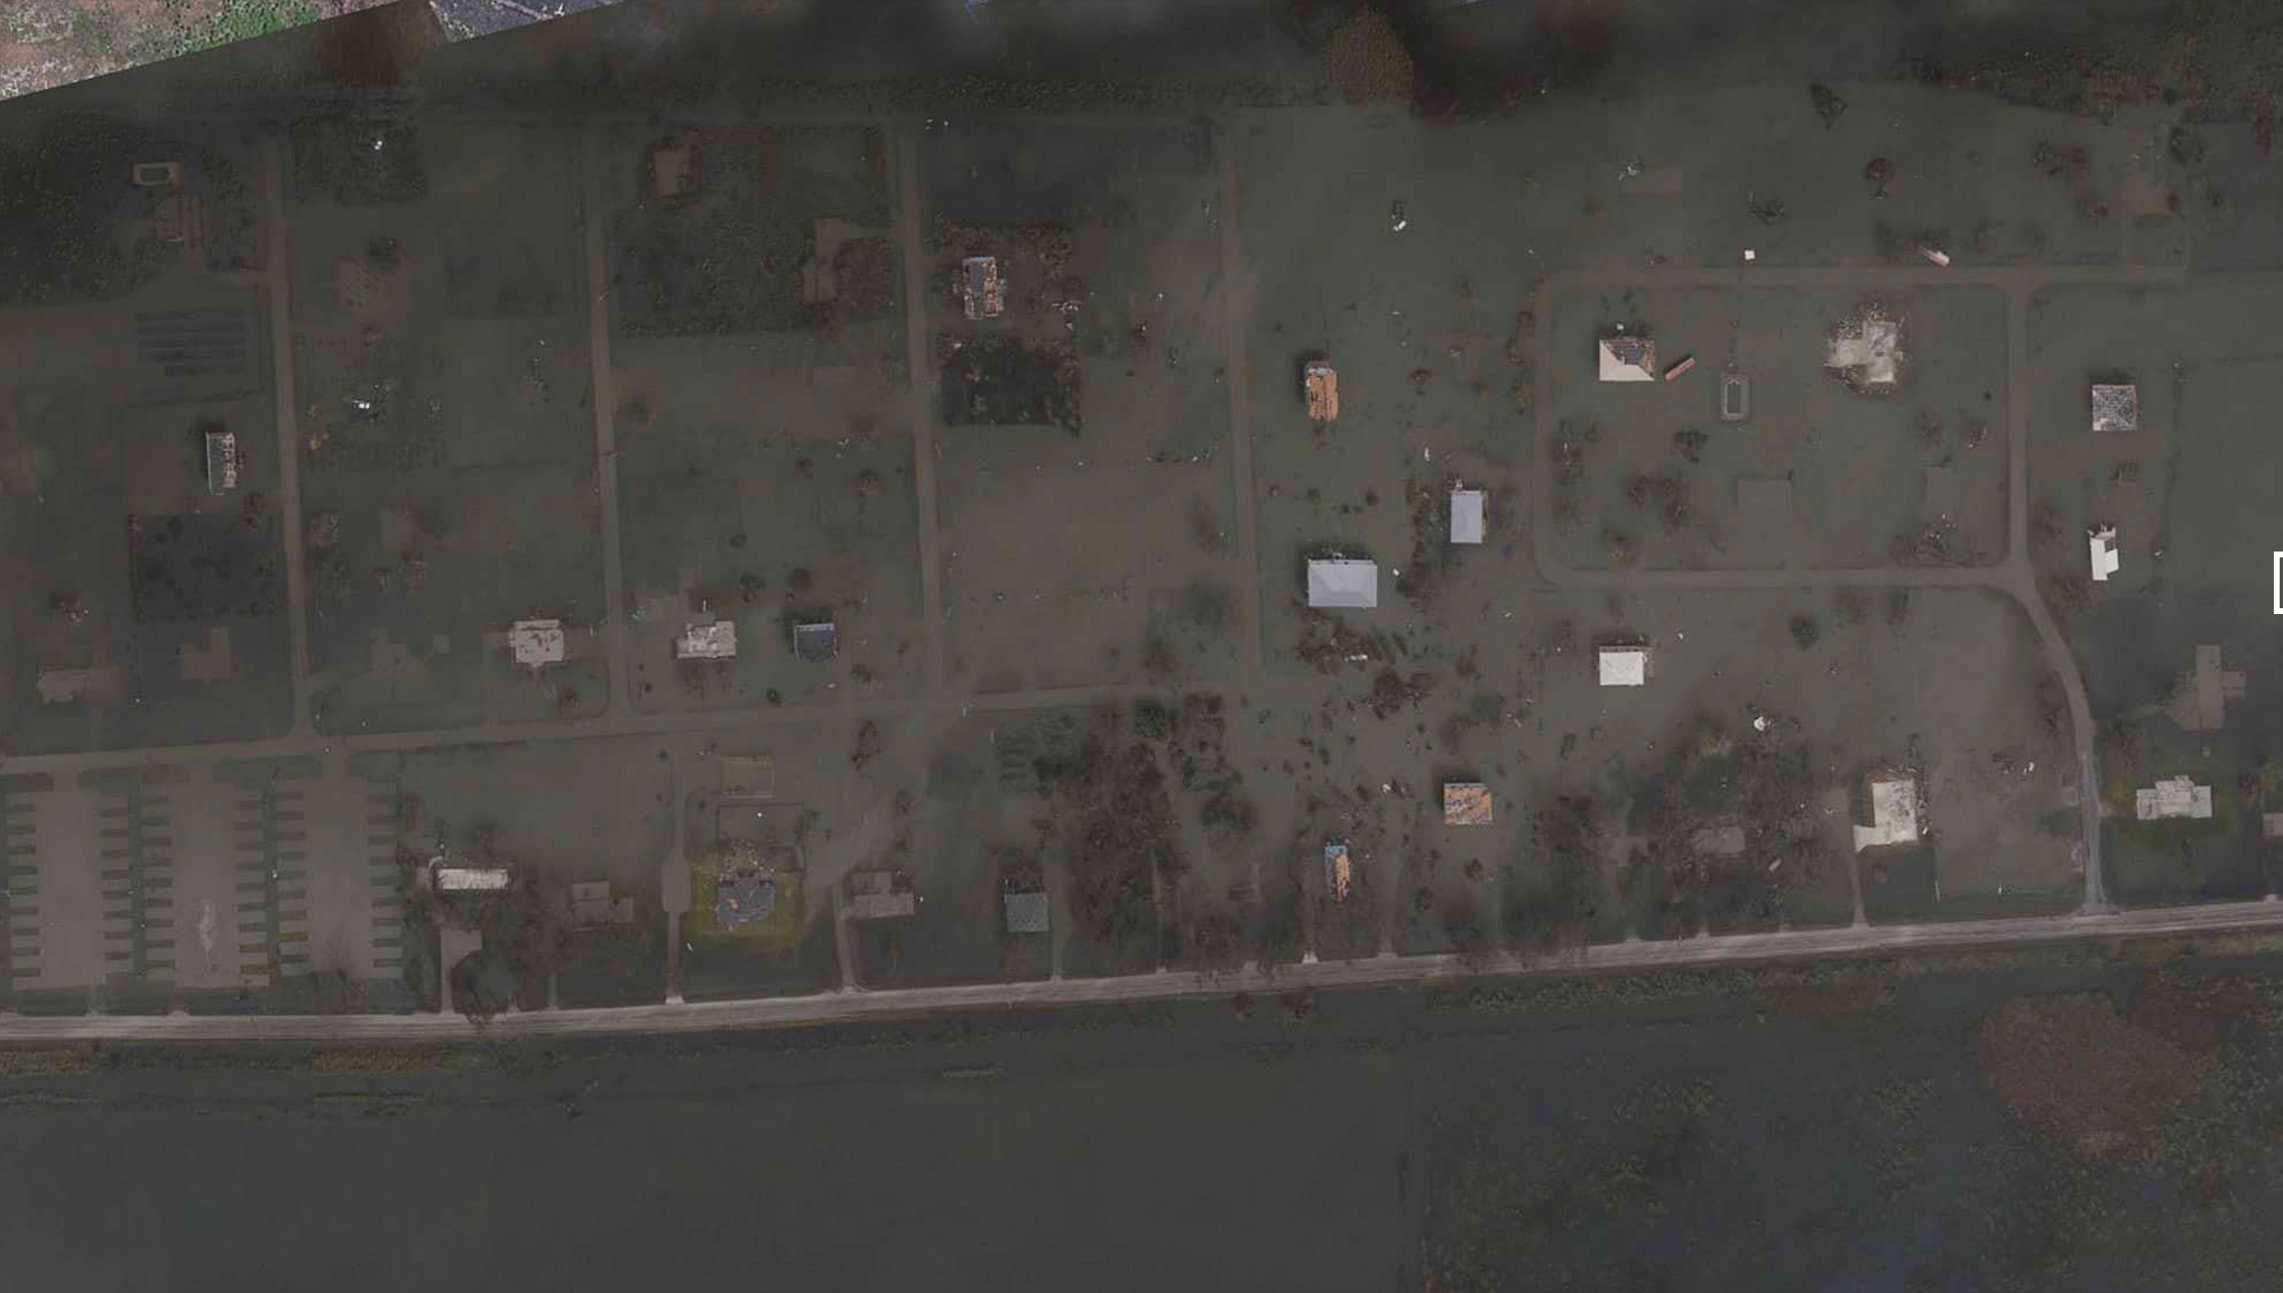
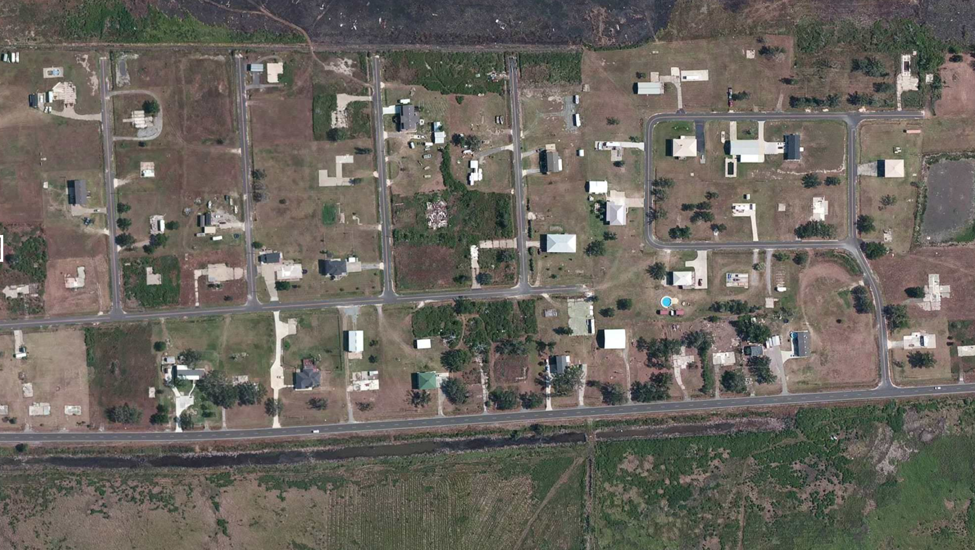
AFTER
BEFORE
Cameron, LA Hurricane Laura
LAND
Water
Notes:
⌂Hurricane Laura in 2020 (not Katrina) was the strongest to hit Louisiana since 1856. This is Cameron LA. ⌂ We need to improve forecasting and intensification models to ensure evacuations are safe and complete.

Slide 6

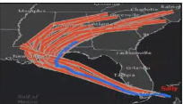
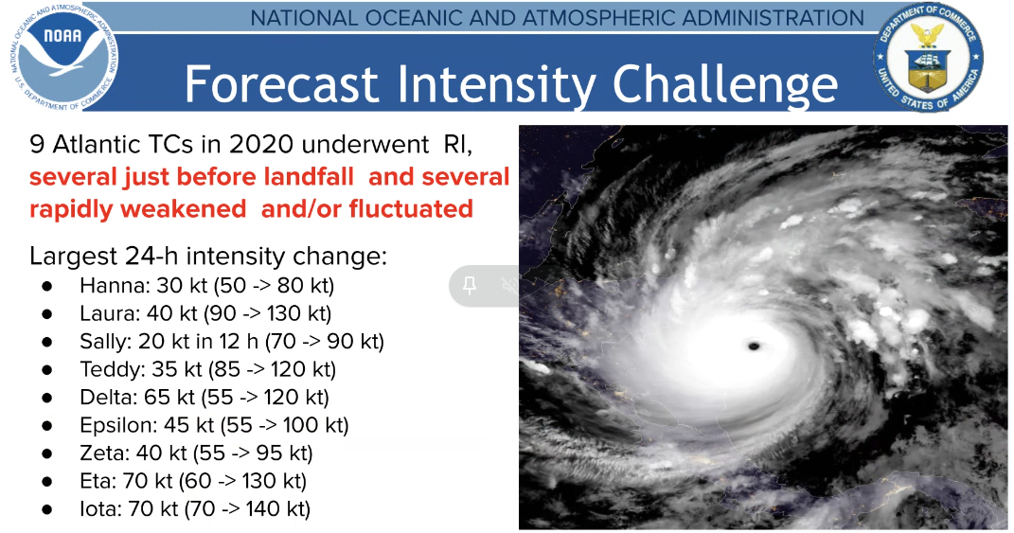
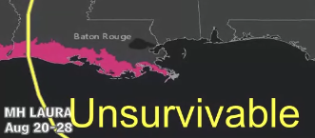
Hours before storm reaches the coast…
72
Mandatory evacuation order issued
30
All lanes travel OUT of the city; last evacuees leave
12
Airport shuts down
Notes:
⌂ The national hurricane center needs 72 hours to evacuate New Orleans but at the 72 hr mark the final track is still unclear and worse yet, Δ 20 storms in 2020 underwent rapid intensification (wind increases by 70 knots!... That’s 80mph) making Δ assessment of danger both uncertain and late. I did not add that “unsurvivable” note - That is an actual model output for hurricane Laura.

Slide 7
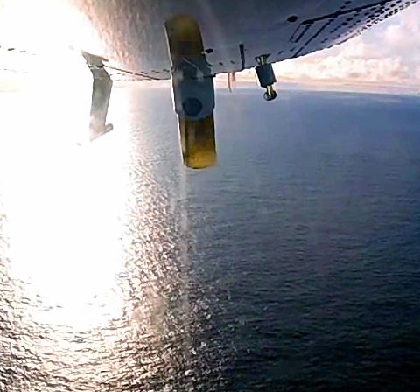
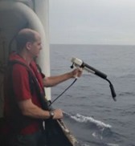
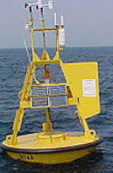
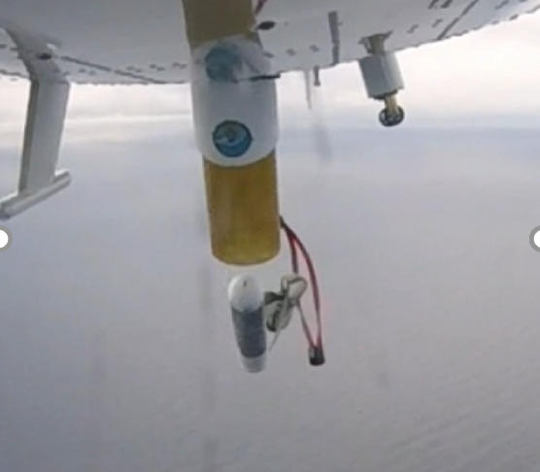
How to improve our data, save lives, and reduce financial losses?
OLD Tech:
XBT
OLD Tech:
Moored Buoy
Boston Engineering MASED
-Low-cost device
-High-cost to deploy
-Single use: 1 data set
-High-cost device
-High-cost to deploy
-Single location
-Many deploy options
-Target needed data!
-Low-cost, multiple profiles
-Data from multiple points up and down
Boston Engineering Sondes:
Notes:
Unfortunately, current ocean data collection methods are lacking. ⌂ XBTs launch off ships, requiring personnel on site, so these low-cost devices have high costs for deployment for one data set. ⌂ Buoys allow sensors to descend and ascend in what are called profiles and provide a lot of data but in a single location, with high costs, the buoy and its deployment. ⌂ Our NOAA variant sonde, called MASED, as shown here in an air-drop test, addresses this gap.

Slide 8
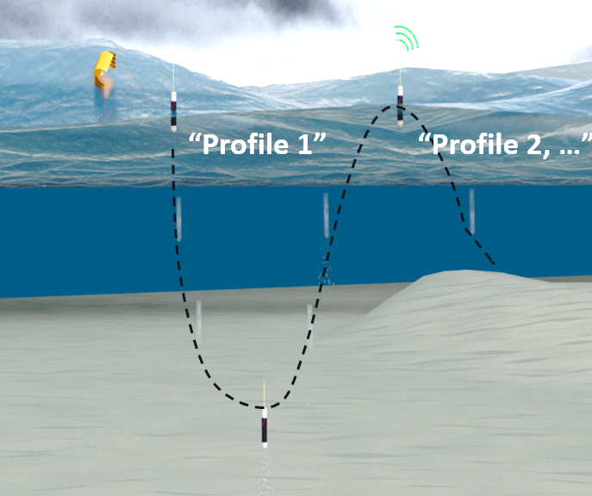
Our sondes collect and transmit real time data through multiple submerge and surface cycles
Lower Cost per Measurement
Localized Data
Worldwide Comms
State of the Art
Variations of Data
Data Access and Tools
Pre-conditions
Intensity-Specific Data
8
Notes:
Our sondes collect more data at a lower cost via several profiles from an expendable (if that’s desired) device. Data-focused customers get what they need… ⌂ lower cost and targeted data ⌂, worldwide connectivity in a state-of-the-art technology, ⌂ variations in data they collect, access, and manipulate it, and ⌂ specific to MASED: ocean preconditions and upper-level mixing towards understanding storm intensification.

Slide 9
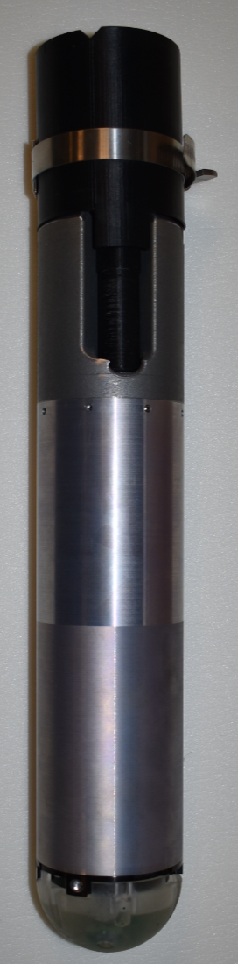
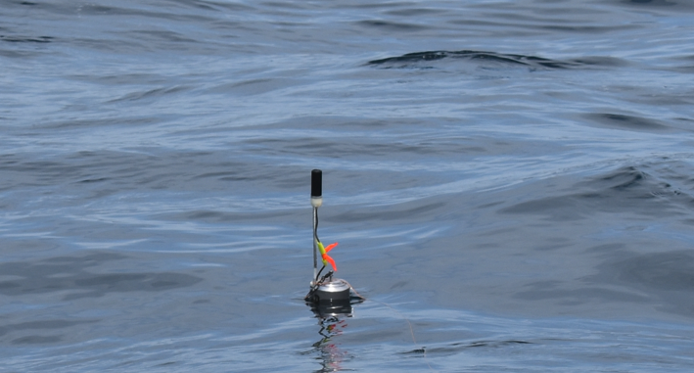
Versatile, modular, marine instruments: Layout
A
B
C
D
E
Notes:
⌂ An auto-detach parachute is an option. ⌂ Our antennas communicate automatically when at the surface. Δ Batteries provide hours to months of operation (depending on version) and use our Δ buoyancy system to profile. Δ Low-cost conductivity temperature and depth sensors can be swapped with others in our open-architecture software.

Slide 10

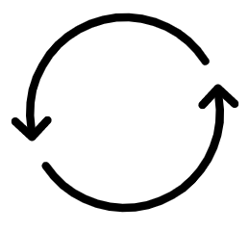

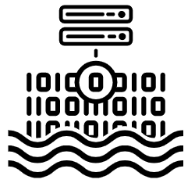

2021 End to End Mission Success!
Air-drop from NOAA aircraft
Multiple profiles to 200m. 93.2% depth accuracy
Robust CTD including comparison to baseline sensors and sea buoys
Iridium satellite comms – fast and reliable from ocean surface
Notes:
In 2021, we completed delivery and test of 20 prototypes with the NOAA aircraft operations center in FL. From a high level, we proved the mission: from airdrop, to multiple dives, to data collection and offload.

Slide 11
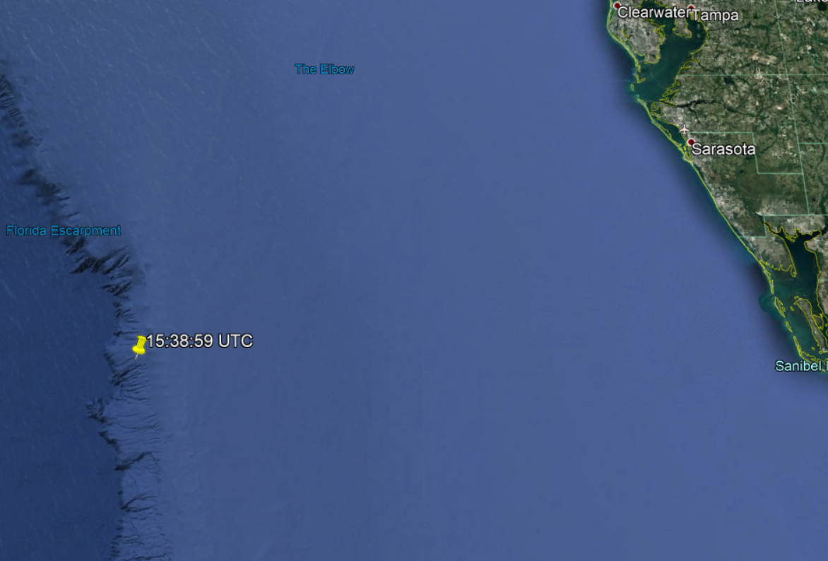
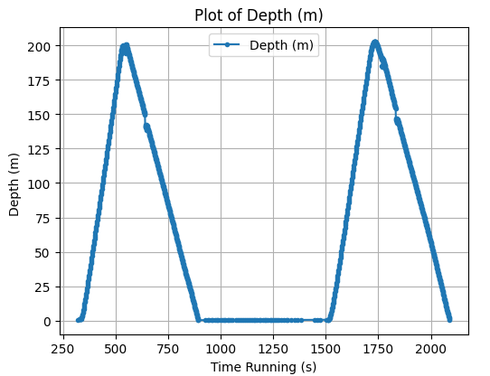
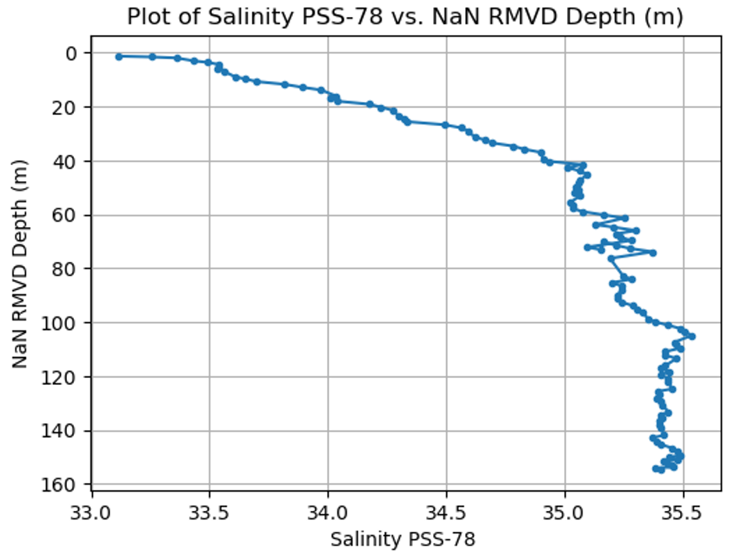
Sample MASED Data
FLORIDA
Notes:
Actual MASED data from the GoM is shown here; on top, 2 profiles to 200m. Temperature-corrected salinity is in the lower plot. The GPS point is from the sonde reporting its location upon splashdown after exiting the P3 aircraft.

Slide 12



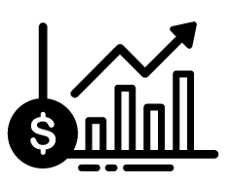


Next Steps
Integrate
Investment
Product Development
Demo
Sales
Shows
Notes:
We’re looking for additional investment to complete MASED product development. We’ll integrate it and its data into customer systems and models, build customer confidence through repeatable data exhibited via demonstrations. Overall, we hope to improve how scientists, emergency personnel, and our friends on the Gulf Coast and beyond work and live. Thank you.

