Slide 1
Facilitating Systemic Leadership & Collaboration
In the Blue Economy
SEACHANGE RESOURCES

Slide 2
Who is SeaChange Resources?

Slide 3
Mineral Resources
Aquaculture
Transportation
Tourism
Ship Building
Renewable Energy
Fisheries
Bio Technology
Oil & Gas

Slide 4
Learning & Change Agility
Clear Communication
Feedback
Prioritization
Technical
Training
Lasting
Results
Leadership
Development
Conflict Management
Influence
Resiliency
Situational Awareness

Slide 5
THE SEACHANGE SUITE

Slide 6
Notes:
Swap/Update
sexy new course
talk about partnership without naming unity

Slide 7
Notes:
Swap/Update
sexy new course
talk about partnership without naming unity

Slide 8
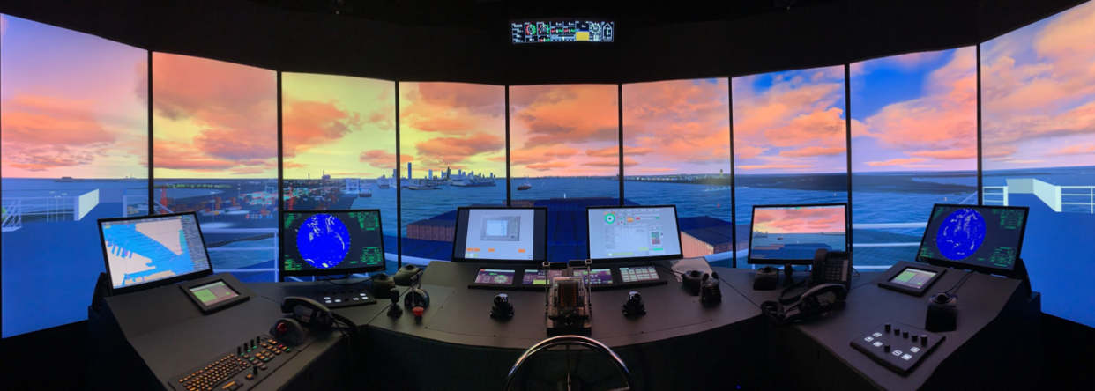
MaritimeQuest
Equip Leaders and their Teams for Peak Performance

Slide 9
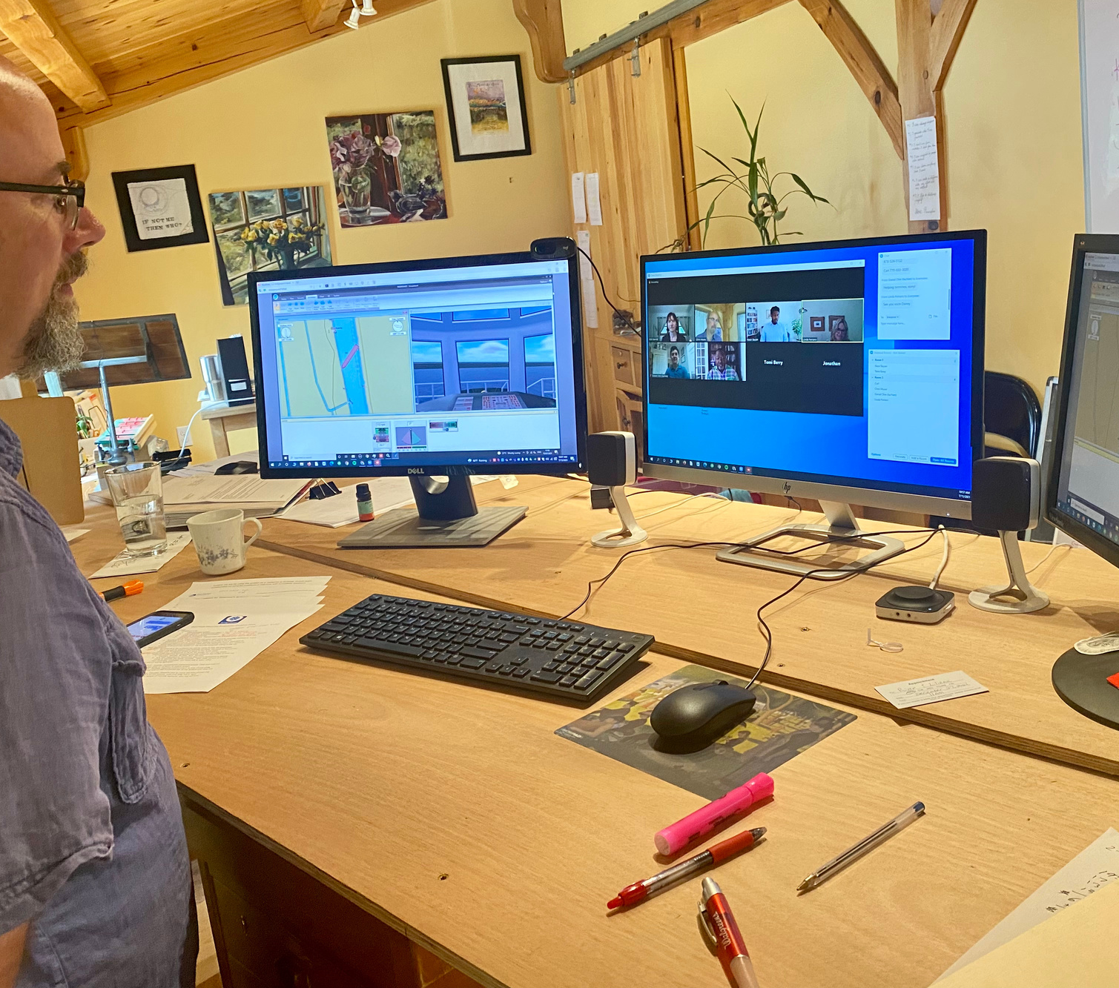
BridgeQuest
Equip Teams and Organizations for
Virtual Management
and Leadership
Notes:
Drop all the benefits from BQ
Keep picture

Slide 10
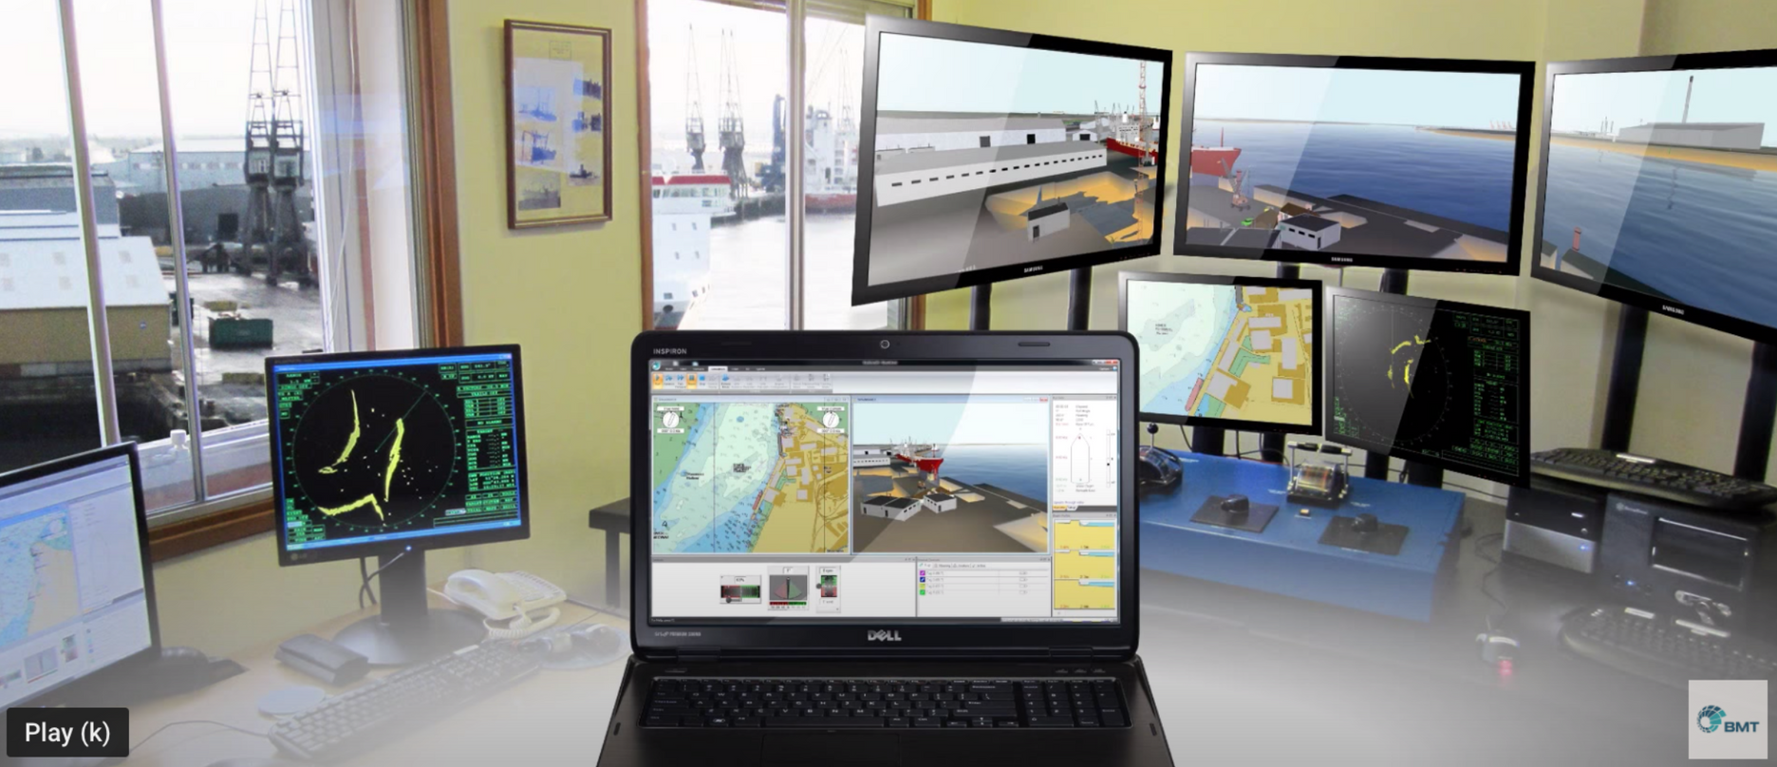
BridgeQuest
SIMULATOR ON A LAPTOP

Slide 11
THE SEACHANGE SUITE
Equip Leaders
with the essential
SeaChange Toolkit
Equip Leaders &
their Teams for
peak performance
Equip Teams & Orgs for virtual management & leadership

Slide 12
Lessons Learned
FROM REMOTE LEADERSHIP

Slide 13
Equip Your Team
to Lead and Collaborate
In the Blue Economy
Let's Talk
Kim Parrott
kparrott@seachange-resources.com
207-266-0172
SEACHANGE RESOURCES

